Slide 1

4. Programming Skills

Slide 2

Approach
1-Sorting - Three different sorting algorithms and their programs
2- Write below programs on collection.
Write a program to add an element at the particular index of the Array List?
Write a program to convert LinkedList to Array List?
Write a program to remove elements from the specified index of the Array List?

Slide 3
Sorting
Sorting is the process of arranging a collection of data elements in a specific order.
The data elements can be arranged in ascending or descending order based on specific criteria, such as numerical value, alphabetical order, or date/time order.

Slide 4
Types of Sorting Algorithms
Bubble Sort
Insertion Sort
Selection Sort
Quick Sort
Merge Sort
Heap Sort

Slide 5
Quick Sort
Divide-and-conquer algorithm
Pivot element and partitions
Efficient for large datasets.
Advantages of Quick Sort
Faster
In-place sorting algorithm
Easy to implement
Time complexity of O(n log n)
Disadvantages
Worst-case time complexity of Quick sort is O(n^2)
Not stable

Slide 6
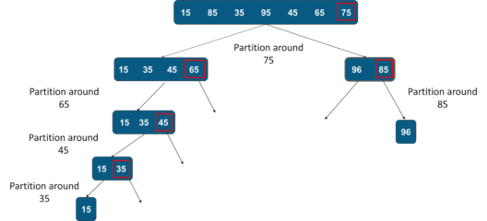

Slide 7
Merge sort
Divide-and-conquer algorithm that recursively
Splits the list into smaller sublists,
Sorts them and then merges them back together.
Advantages
Faster
Worst, average and Best-case time complexity of O(n log n)
Efficient for large datasets.
Stable sorting algorithm
Disadvantages
Not an in-place sorting algorithm
Space complexity of O(n)
Slower for small input sizes.

Slide 8
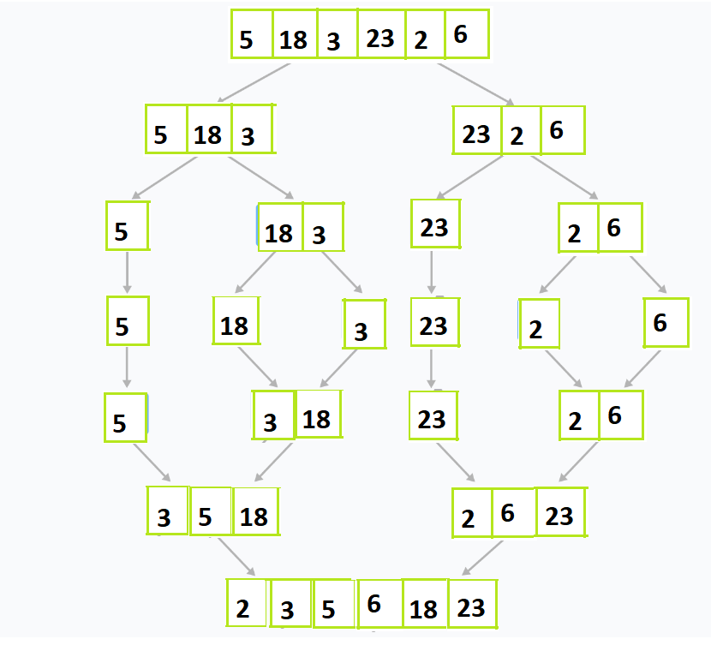

Slide 9
Heap sort
Binary heap data structure to build the sorted list.
Advantages
Efficient for large datasets.
Worst, average and Best-case time complexity of O(n log n)
In-place sorting algorithm
Disadvantages
Less efficient for smaller data sets.
Not stable

Slide 10
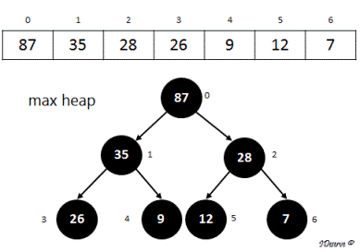

Slide 11
Collections
Array List – Adding, Removing
Linked List To Array List

Slide 12

Thank You
By
Alekhya

